Slide 1

AUTONOMOUS DATA QUALITY:
ENTERPRISE WIDE SMART CHECKS
VISIONARY VECTORS

Slide 2

Problem statement- Business Context
Organizations are dealing with rapidly growing, complex, and continuously changing data across multiple systems.
Traditional rule-based data quality checks are rigid — they cannot adapt to new data patterns without frequent manual updates.
This leads to:
Missed anomalies and inconsistent data validation
High operational effort to maintain hundreds of rules
Delayed decision-making due to unreliable or unvalidated data
Escalating maintenance costs as data grows
These limitations cause project delays and increased operational costs. To address these issues, enterprises need smarter, adaptive solutions-like Al-driven automation-that can learn from evolving data, automatically refine validation rules, and ensure scalable, transparent, and auditable data quality management.

Slide 3

GARTNER TREND STUDY
Why is data quality important to an organization?
Data quality is important because accurate, consistent, and reliable data enables better decisions, improves operational efficiency, and reduces risks. It strengthens customer trust, supports AI and analytics, and prevents costly errors that impact revenue and performance.
Poor data quality costs ~$13M/year and is the top barrier to AI adoption (Source : Data Quality Market Survey (2023–2024) – Gartner)
FUTURE TRENDS IN DATA QUALITY :
By 2027, 70% of organizations will adopt modern data quality solutions to better support their AI adoption and digital business initiatives.
By 2027, 80% of mainstream data quality vendors will leverage large language models (LLMs) and natural language processing (NLP) to enable interactive user inference in order to improve user productivity and tool efficiency.
By 2027, the application of generative AI (GenAI) will accelerate the time to value of data and analytics governance and master data management (MDM) programs by 40%.

Slide 4
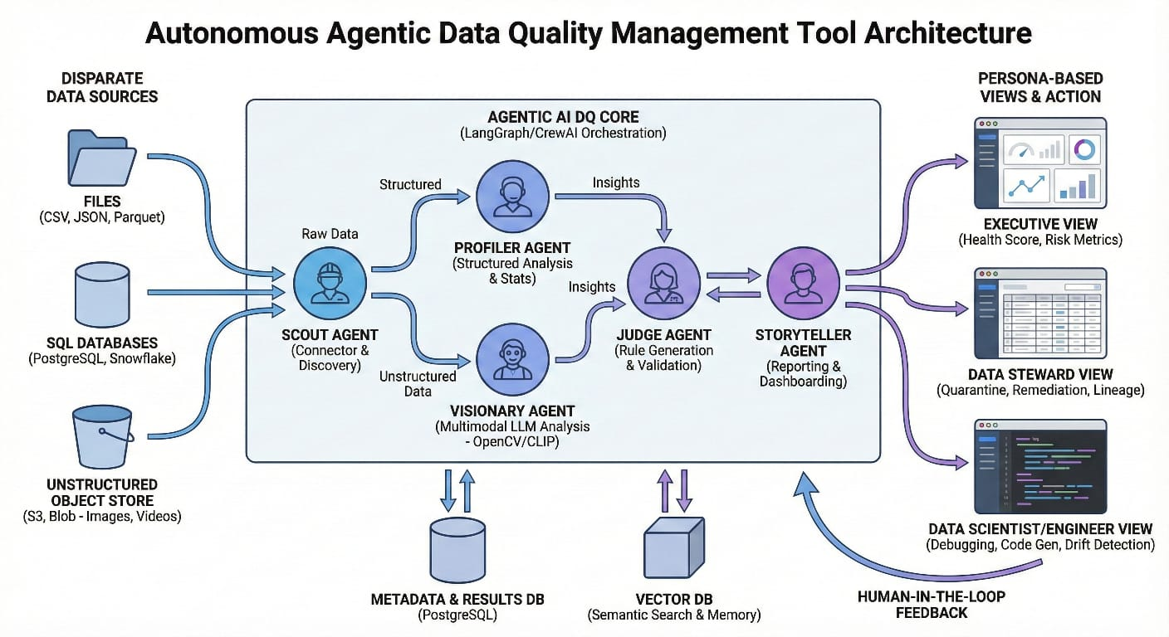

Slide 5
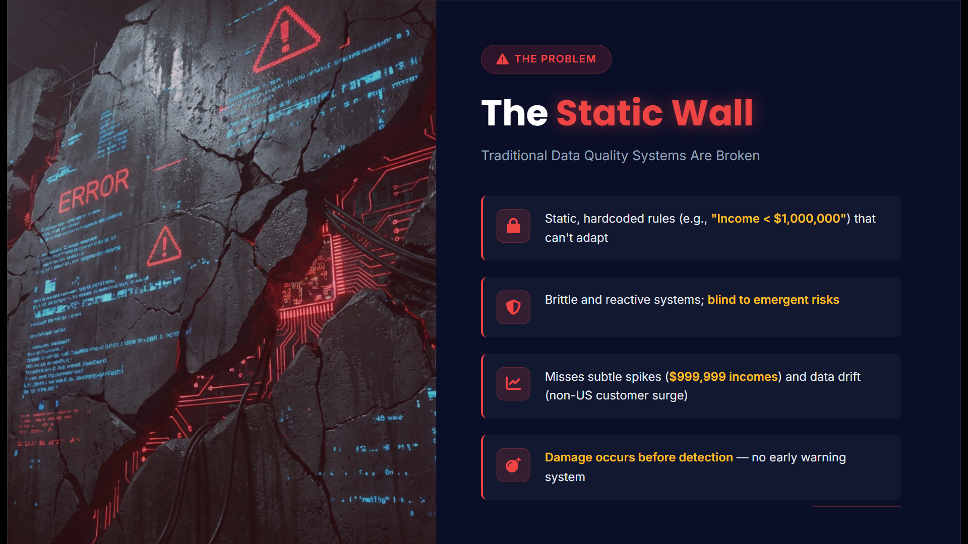

Slide 6
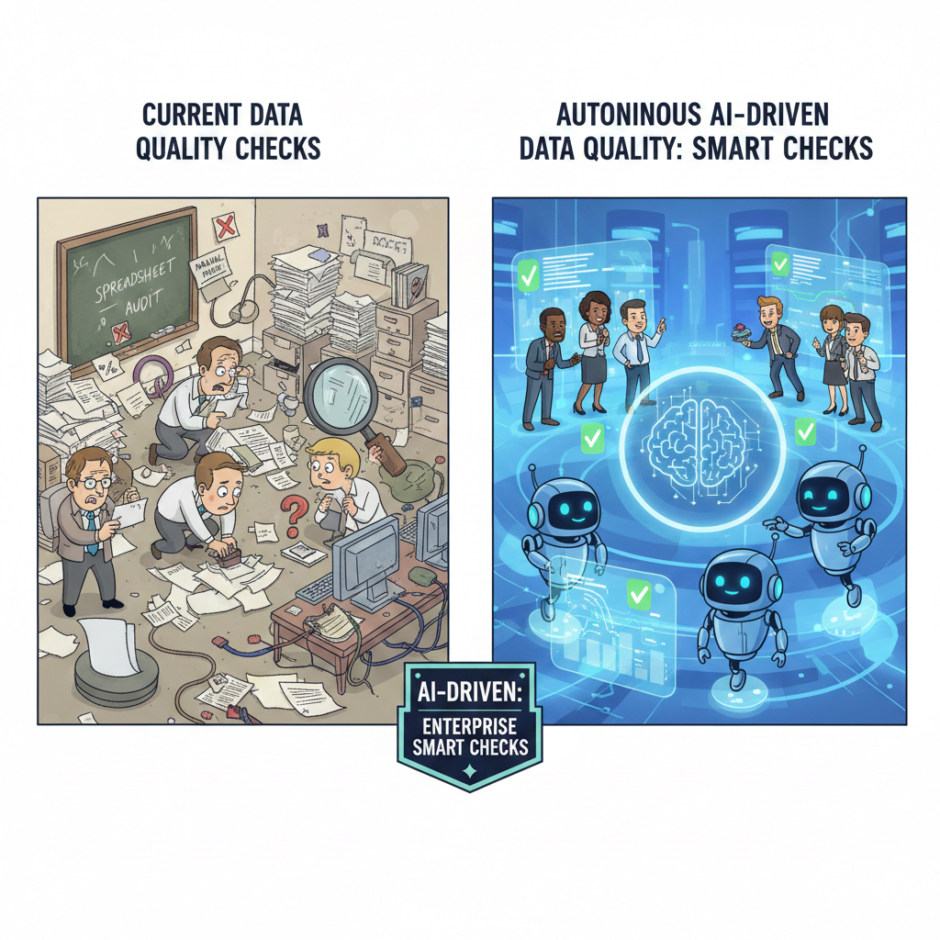
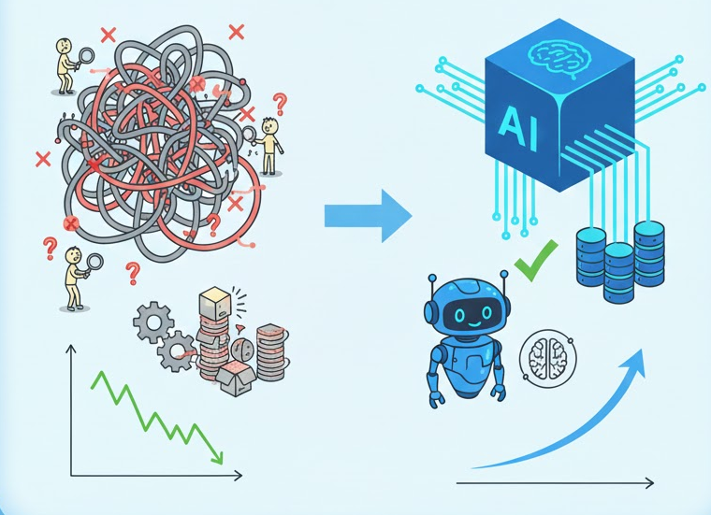
TRADITIONAL vs AUGMENTED DQ CHECK
Feature | Autonomous AI Agents (e.g., Scout, Profiler, Rule Generator) | Traditional Data Quality (DQ) Systems
Action | Proactive & Prescriptive: Detect, diagnose, and automatically remediate issues in real-time. Predicts future issues. | Reactive & Descriptive: Detects and flags issues, usually in batch processing. Requires human intervention to fix.
Rules & Logic | Adaptive & Self-Learning: Uses Machine Learning (ML) to automatically discover and update rules based on data patterns and context. | Static & Manual: Relies on pre-defined, rigid rules that must be manually coded, updated, and configured by a Data Engineer/Steward.
Processing | Real-Time: Continuous 24/7 monitoring and validation as data streams into the system (ingestion). | Batch-Based: Runs checks on scheduled intervals (e.g., nightly, weekly), leading to a delay in correction.
Scalability | Highly Scalable: Handles massive, diverse, and rapidly growing data volumes effortlessly. Intelligence scales with data growth. | Strains at Scale: Requires proportional increases in manual effort and computational resources to maintain.
Efficiency | High Efficiency: Automates 80%+ of repetitive tasks (profiling, cleansing, validation, rule generation), freeing human experts for strategic work. | Labor-Intensive: High human effort required for setup, maintenance, rule updates, and root cause analysis.
Context | Context-Aware: Agents (like the Visionary or Story Teller) understand the business impact of a data issue, prioritizing high-risk corrections. | Context-Blind: Focuses on technical metrics (e.g., completeness, accuracy score) without inherent understanding of business value or risk.

Slide 8
SOLUTION

Slide 10
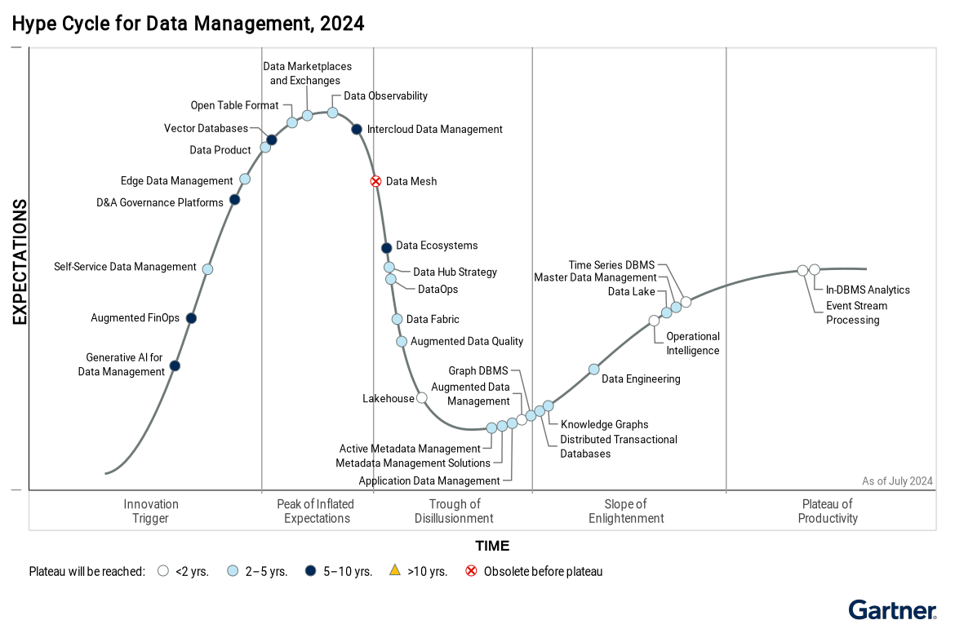
GARTNER HYPE CYCLE FOR DATA MANAGEMENT

Slide 11
BUSINESS IMPACT – DRIVERS FOR AUTOMATION
Impacts of Poor Data quality on Business:
Companies lose 20–30% of revenue due to poor-quality data (incorrect transactions, errors, inefficiencies).(McKinsey – Data Transformation Benchmark (2022–2024))
70% of failed AI projects are attributed to poor data quality and lack of clean training data.(MIT Sloan & BCG – Global AI & Data Report (2023))
91% of companies report that data quality issues limit their business performance.(Experian – Global Data Management Research (2023))
Drivers for Autonomous Data Quality Checker:
Huge volume and complexity of modern data
AI systems relying on poor-quality data produce unreliable, biased, or unstable results ("garbage in, garbage out").
Traditional data quality checkers face high maintenance costs and operational inefficiencies.
Inability to detect subtle shifts in data patterns

Slide 12
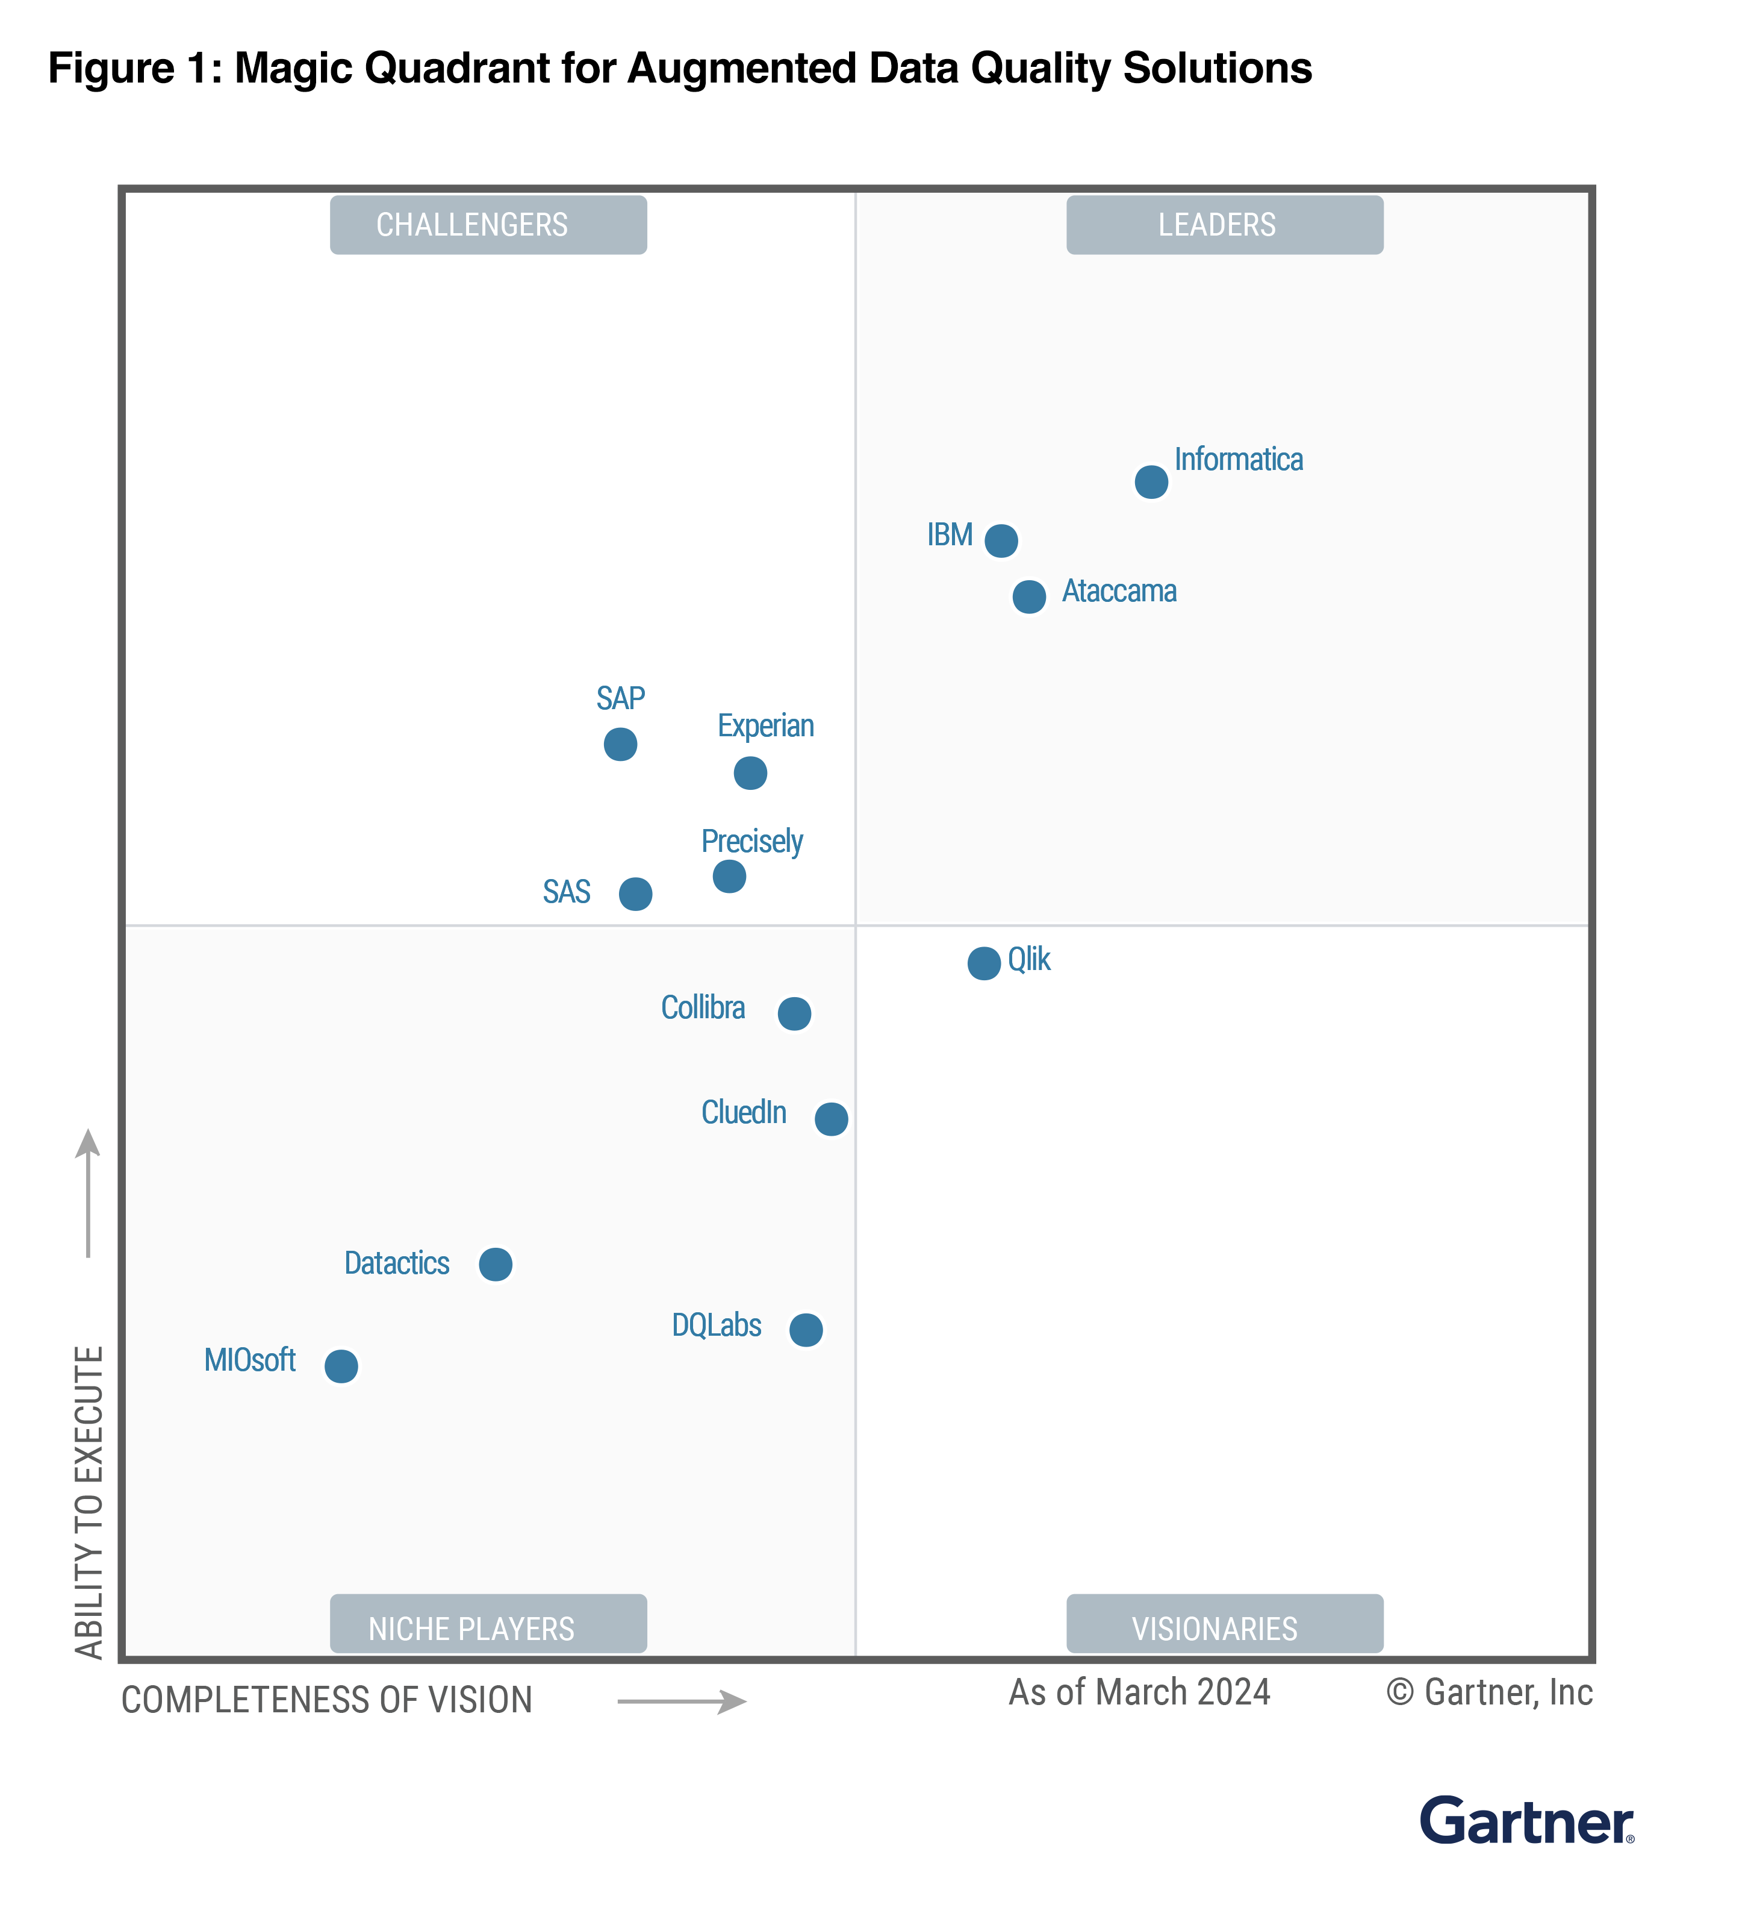
Gartner Magic Quadrant for Augmented Data Quality Solutions

Slide 13
SOLUTION
Input: Data Streams + Metadata + Business Glossary
Core: AI Agents (Rule Generation, Anomaly Detection, Remediation)
Output: Trusted Data + Explainable Insights + Auditable Rules

Slide 14
Proposed solution Architecture

Slide 15
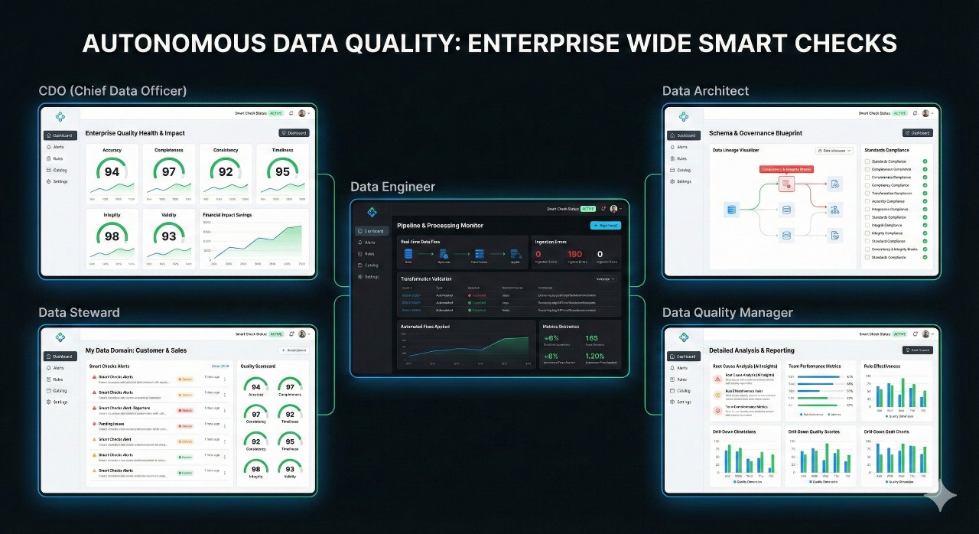
Proposed Solution Mockup

Slide 16
Automated Data Validation and Anomaly Detection
Real-time identification of outliers, duplicates, and inconsistencies using ML models.​
Self-learning algorithms flag subtle errors without predefined rules.​
Continuous Learning and Rule Refinement
Models adapt to evolving data patterns by analyzing historical issues and predicting future problems.​
Automatic generation and updating of validation rules from metadata and user feedback.​
Proactive Context-Aware Quality Management
Contextual analysis via LLMs for understanding data semantics and business rules.​
Predictive analytics to anticipate issues before they impact operations.​
Scalable and Transparent with Audit Trails
Handles high-volume streams across multiple sources with full data lineage tracking.​
Explainable AI provides auditable logs and decision rationales for compliance.

Slide 17
Improved Data Trust and Reliability
Up to 95% anomaly resolution, as seen in Vodafone's billing systems, boosting customer satisfaction by 20%.​
25% reduction in data errors and enhanced accuracy through real-time cleansing.​
Reduced Manual Effort and Maintenance Costs
Automates repetitive tasks, freeing staff for strategic work and cutting costs significantly per McKinsey insights.​
80% fewer data quality issues reported by enterprises post-implementation.​
Better Detection of Subtle Data Shifts and Anomalies
Continuous monitoring catches patterns missed by static rules, preventing larger issues.​
Real-time error correction in sectors like retail and healthcare.​
Faster, More Accurate Analytics and Decision-Making
Enables predictive insights and informed decisions with clean, timely data.​
30% increase in customer satisfaction via reliable analytics.

Slide 18
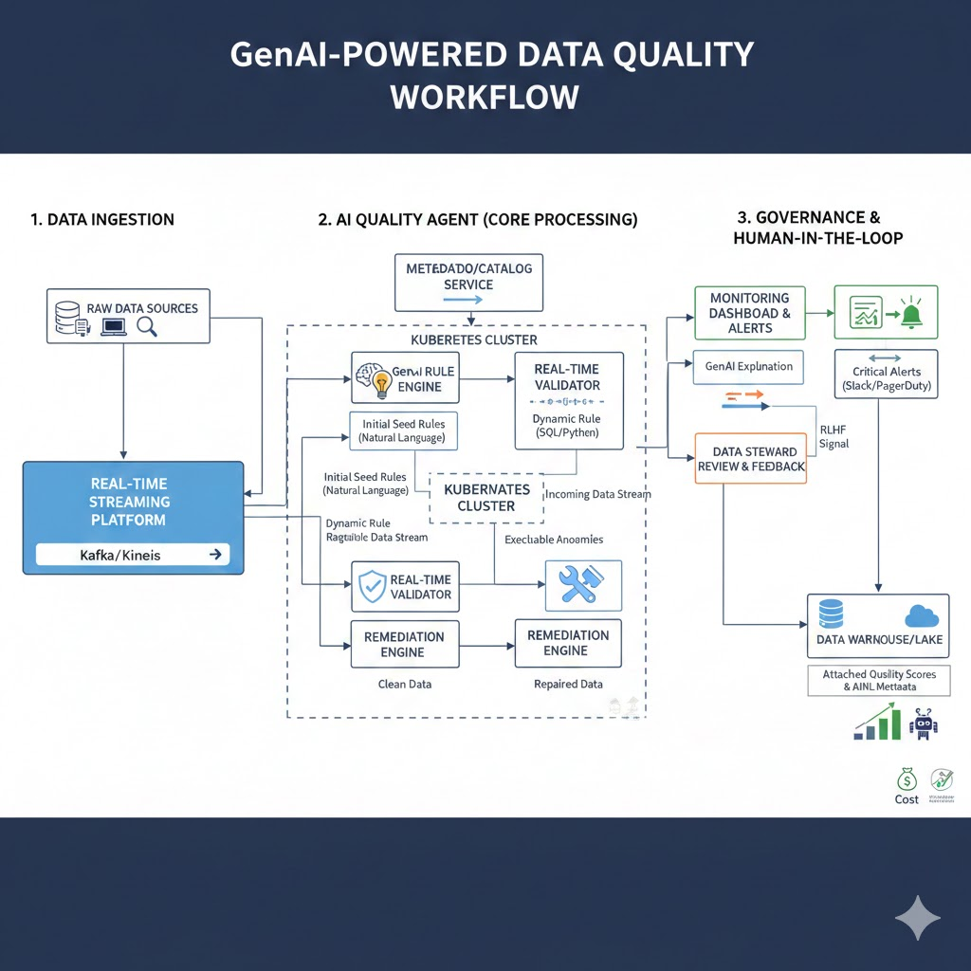
WORKFLOW
Data Ingestion: Securely pulls high-volume feeds from multiple sources.​
AI-Driven Validation & Anomaly Detection: ML scans for errors, outliers in real-time.​
Rule Refinement: Models learn from feedback to auto-update rules dynamically.​
Data Enrichment & Cleansing: Fills gaps, standardizes, and corrects via predictive imputation.​
Continuous Monitoring & Reporting: Dashboards with alerts, audits, and lineage for ongoing oversight.

Slide 19
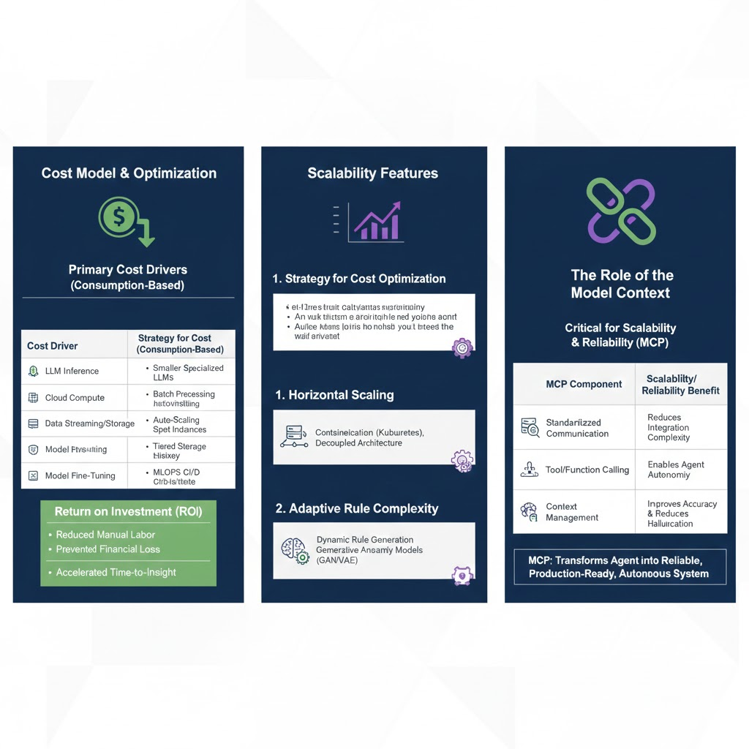

Slide 20
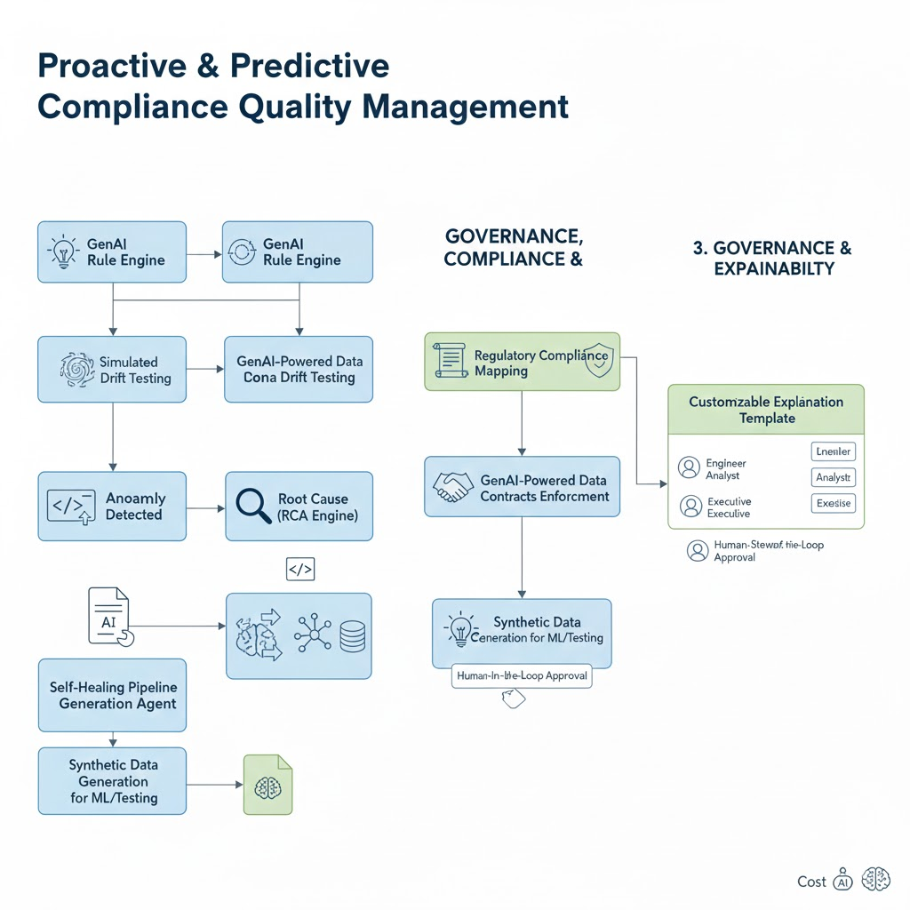

Slide 21
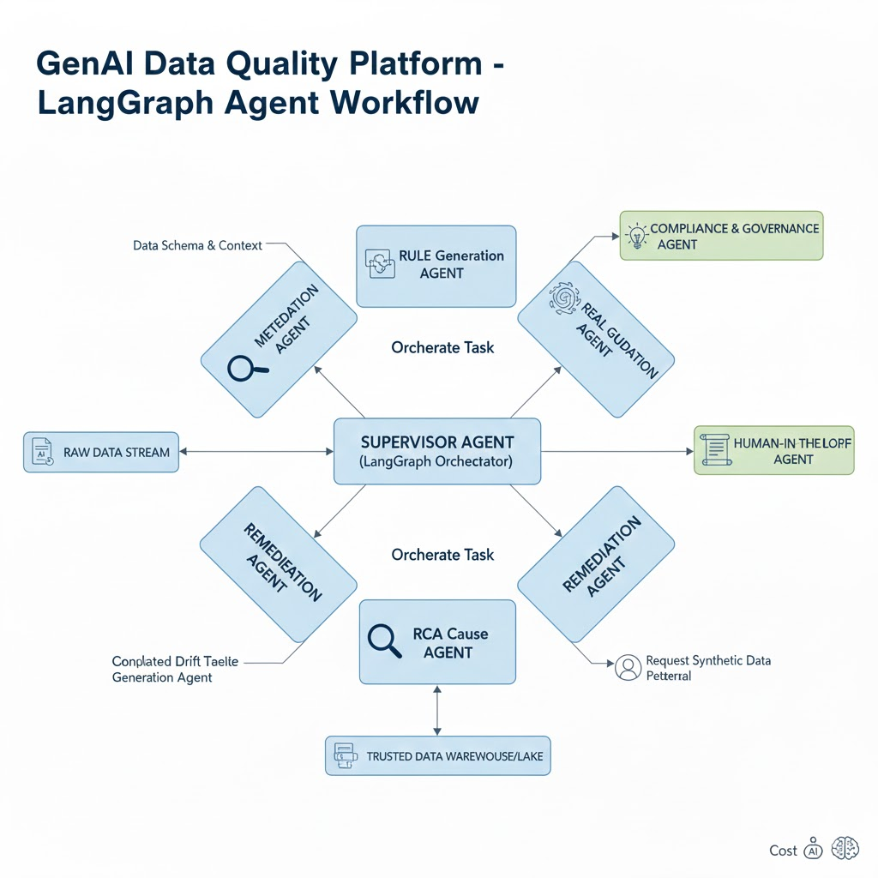

Slide 22
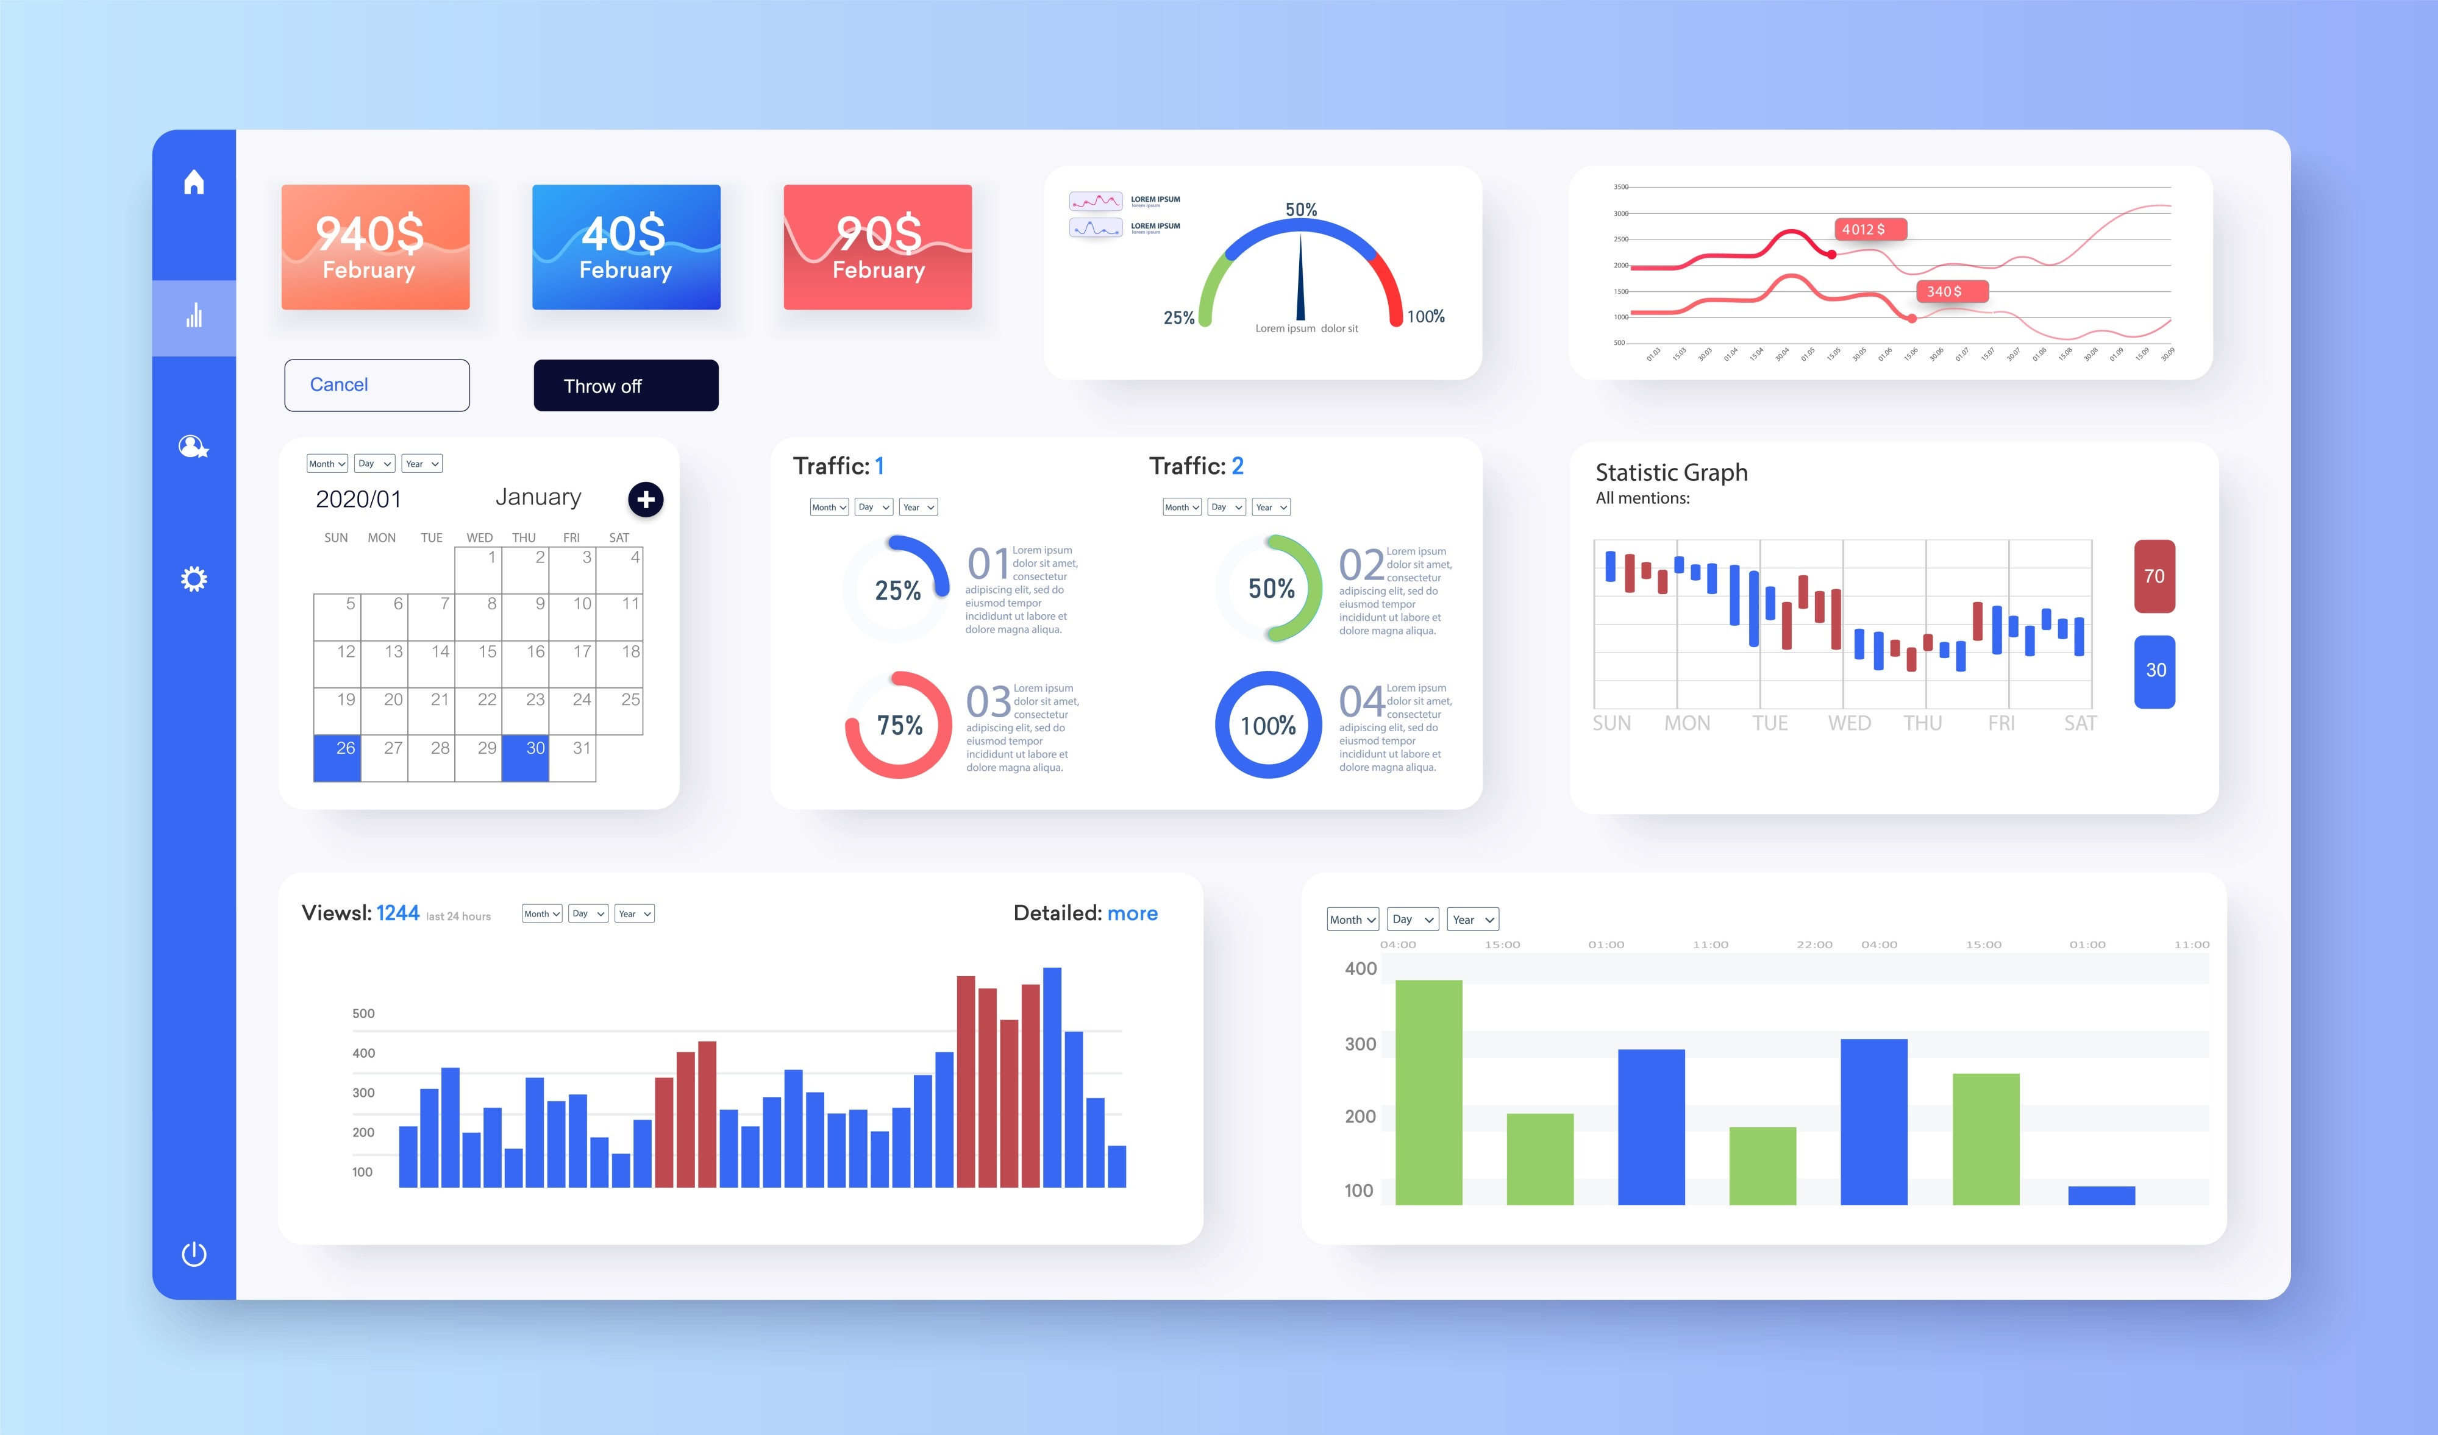

Slide 23
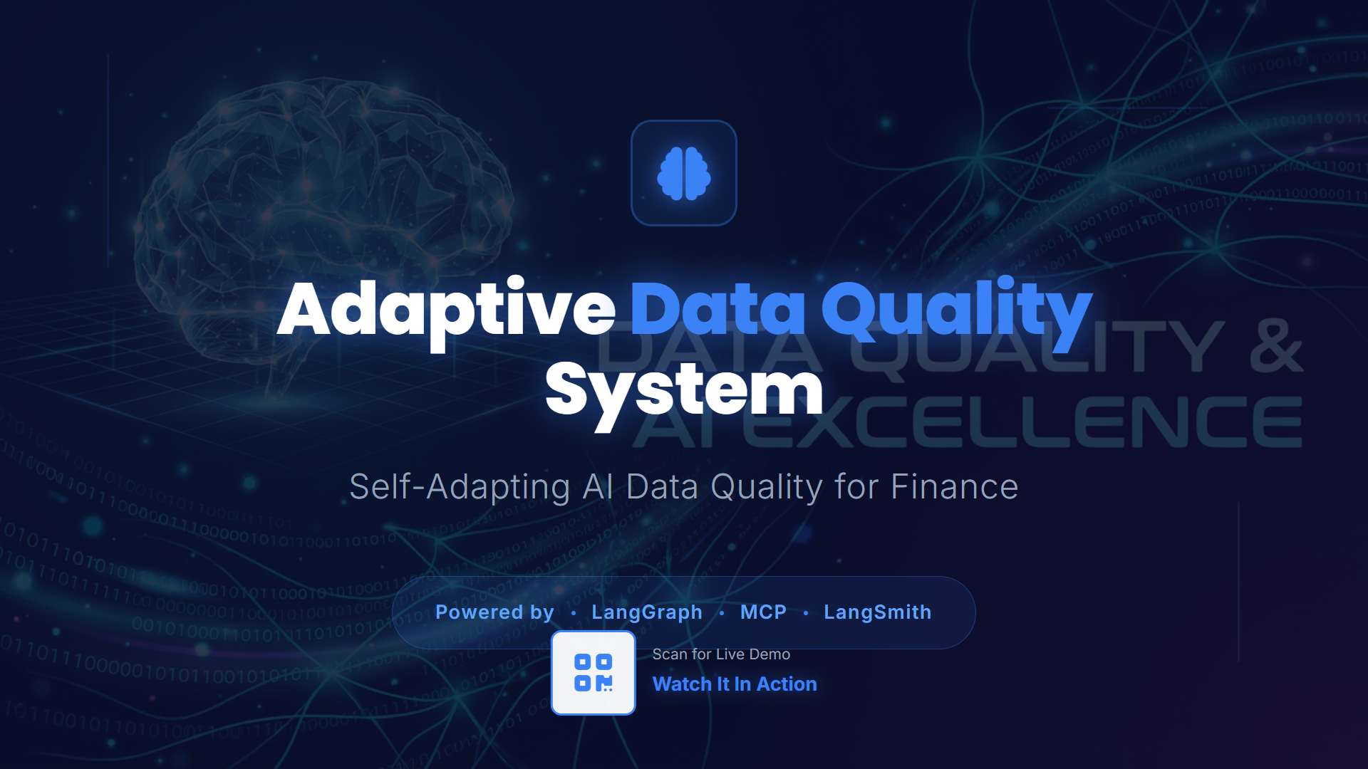

Slide 24
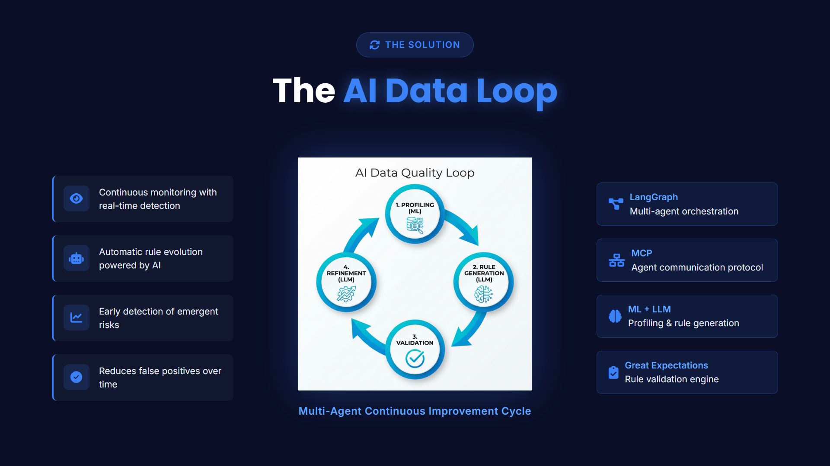

Slide 25
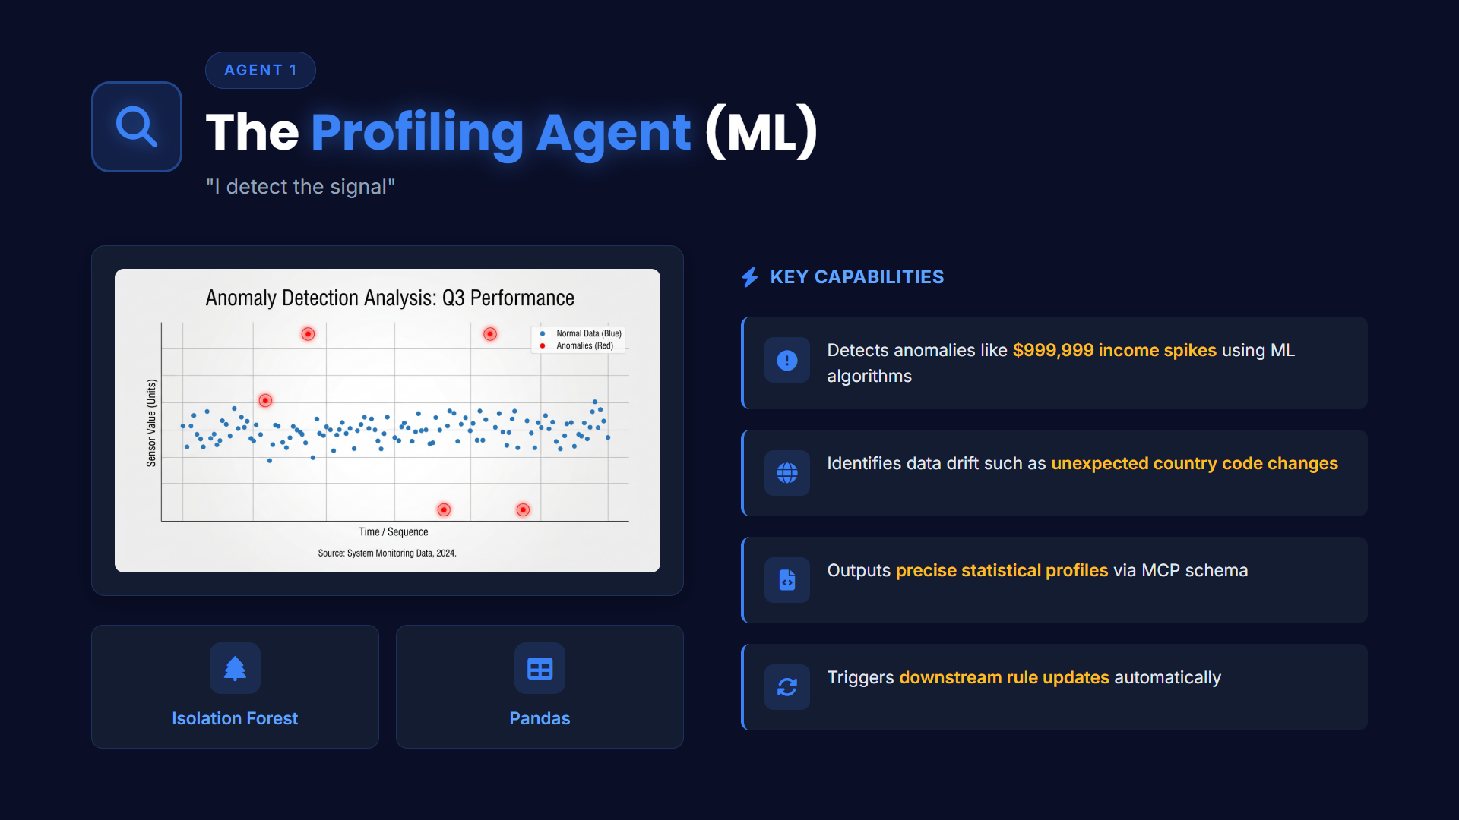

Slide 26
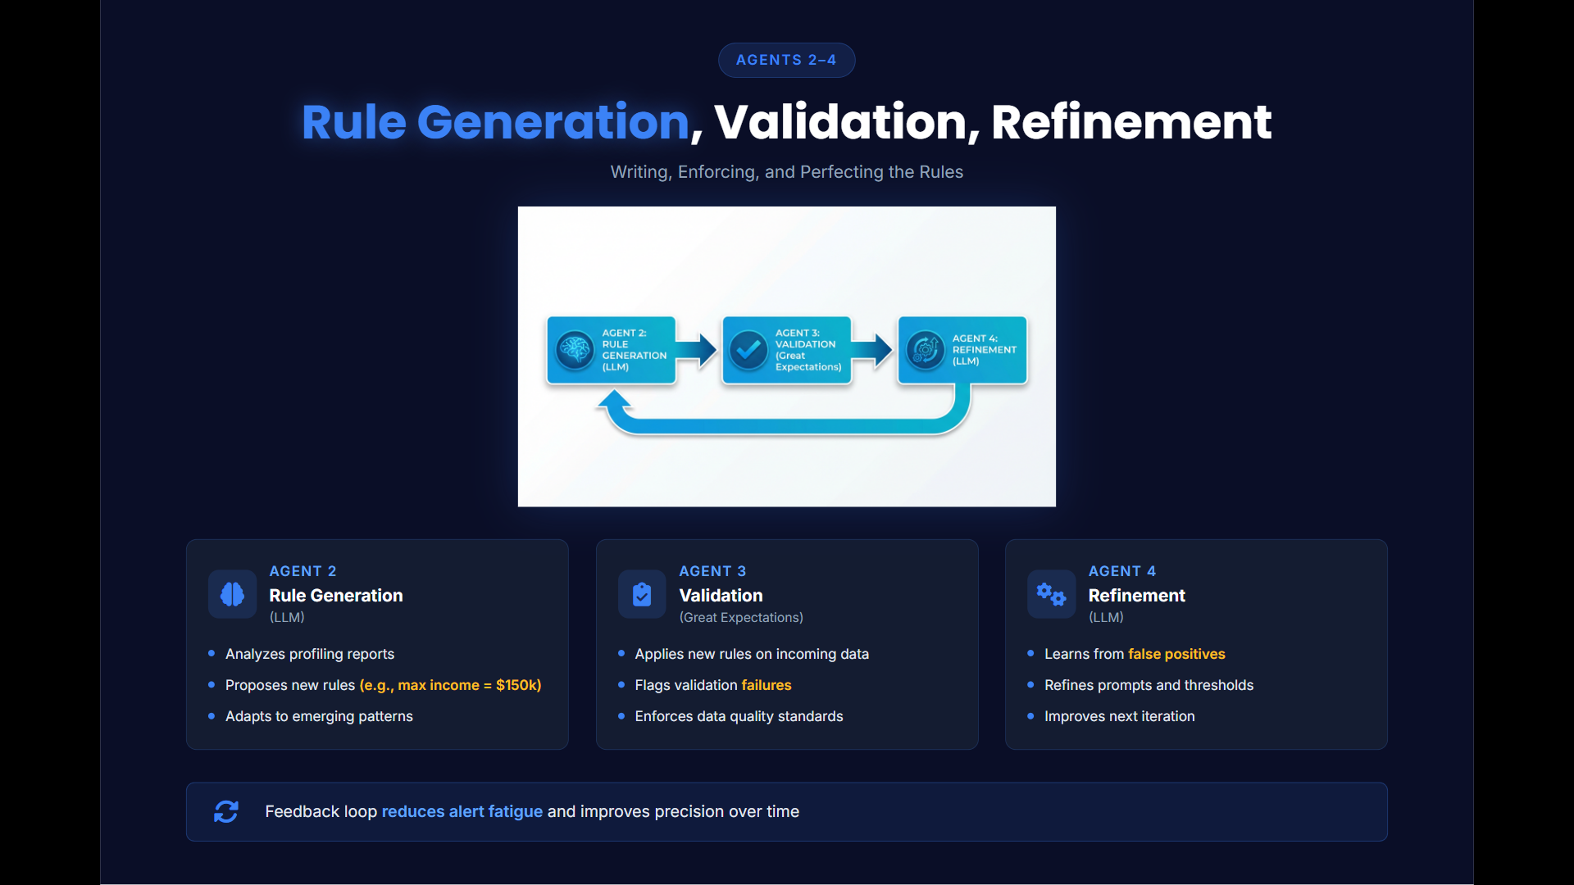

Slide 27
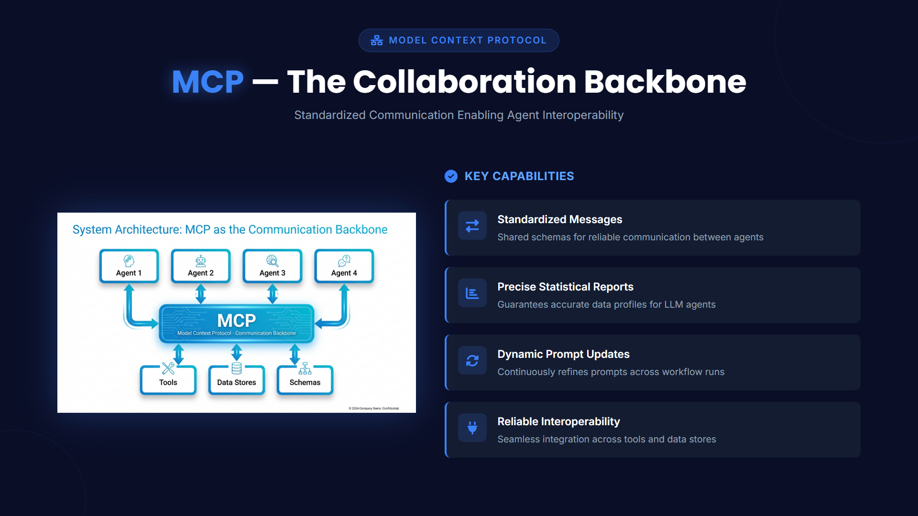

Slide 28
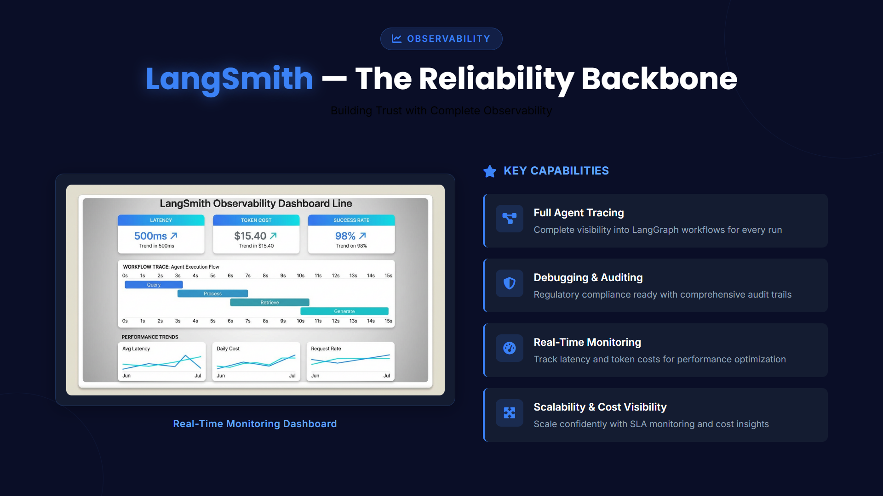

Slide 29
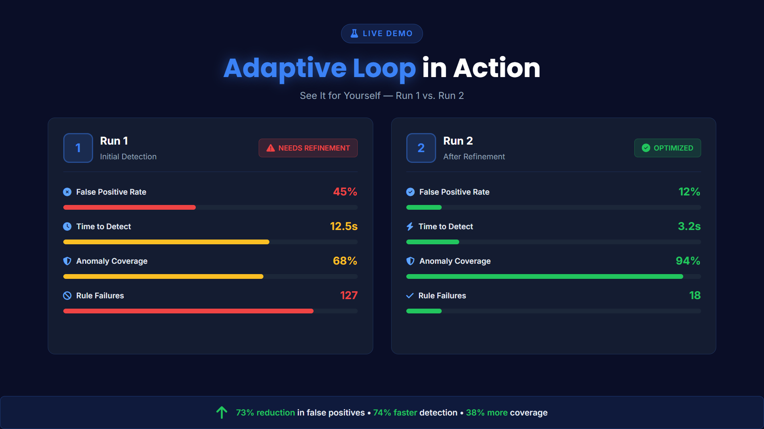

Slide 30
